Slide 1

The first solution is also added to the Tabu List (in case the Heuristic has a Tabu List]
The HLS files refer to when the Tabu List is limited to 50 elements.
The ATS files refer to when the Tabu List is removed altogether.
Next a loop is started for improving the best solution and updating it in every iteration.
Once this loop stops, the existing best solution becomes the output of the Heuristic
Terminating Criteria for the different Heuristic flavours are as follows:-
Algorithm:- When 500 candidate solutions are within the threshold acceptance region and the best solution is not being improved
Flowchart:- When 500 candidate solutions are outside the threshold acceptance region and the best solution is not being improved
Text:- When 500 consecutive candidate solutions are not the best solution
These stopping criterias are monitored using a counter f

Slide 2
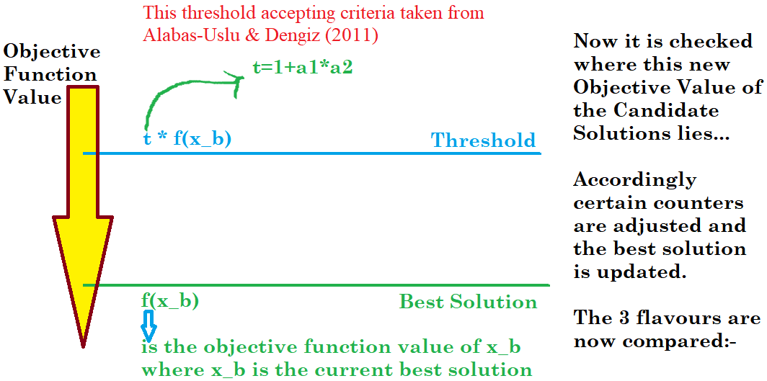

Slide 3
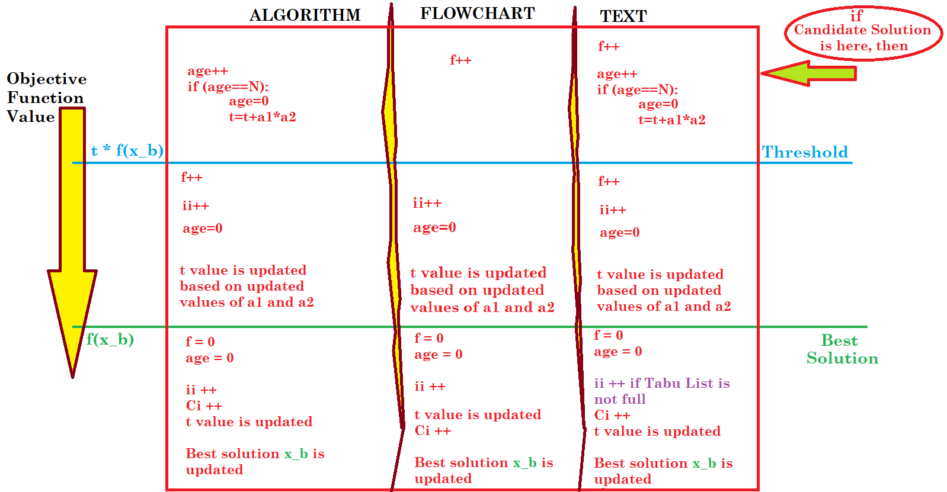

Slide 4
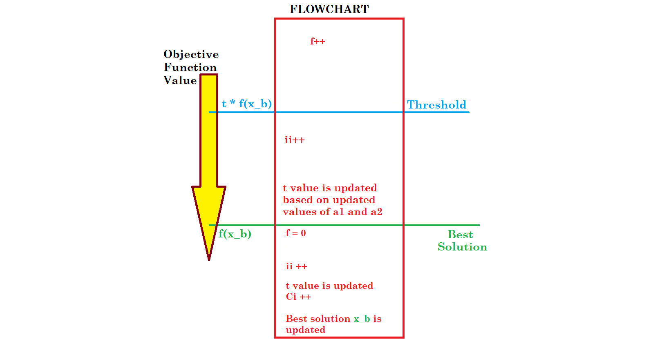
Why in Avci Topaloglu 2016, the Flowchart is wrong and only the Algorithm or the Text should be followed :-
According to the sequence of steps mentioned in the Flowchart, the value of age can never achieve N and so the algorithm will always terminate before intended
Therefore age actually becomes redundant in the Flowchart and may just be removed to see the FLOWCHART.
We can see this logic alongside:->

